Slide 1
Worming – an update
Katie Kershaw BVSc MRCVS

Slide 2
Plan
The worms
Worm control
The wormers
Resistance
RDA

Slide 3
The Worms
Helminths
Nematodes
Strongyloides
Parascaris
Cestodes
Anoplocephala (tapeworm)
Arthropods
Cyathostomins (small strongyles)
Strongylus (large strongyles)
Gasterophilus (bots)
Oxyuris equi (pin worm)

Slide 4
Strongyloids westeri – Threadworm
Age: Very young (birth – 2 months)
From the milk
Clinical signs:
Diarrhoea, lethargy, reduced weight gain
Prevention:
Treat mares before foaling?
Treatment:
Ivermectin

Slide 5
Tapeworms – Anoplocephala perfoliata
Age: 6 months +
Pathology:
Attach at ileocaecal junction
Hyperaemia, mucosal thickening and necrotic ulcers
Clinical Signs:
Colic?
No signs
Treatment:
Pyrantel
Praziquantel
Prevention:
1 or 2 treatments a year?

Slide 6
Tapeworm Diagnosis
Faecal egg counts?
Centrifugation?
Flotation?
Poor sensitivity/specificity
ELISA
Blood – Uni of Liverpool and Rossdales
Saliva – Equisal
Exposed in last 5 months

Slide 7
Pinworm – Oxyuris equi
Age: 5 months +
Pathology:
Irritant proteinaceous uterine fluid, egg masses or more complex?
Clinical signs:
Itchy bottom!
Diagnosis:
Protruding from rectum? Sticky tape - microscope
NOT FEC
Treatment:
Wormer
Cleaning, disinfection
Prevention

Slide 8
Pinworm Lifecycle
Crypts of Lieberkuhn
Ventral Colon
Right Dorsal Colon

Slide 9
Bots - Gasterophilus
Age: any
Clinical signs:
Yellow dots on legs
Significance?
Treatment
Ivermectin/moxidectin
Autumn/Winter – larvae in host

Slide 10
Lungworm – Dictyocaulus arnfieldi
Common in donkeys (supports the whole life cycle)
Clinical signs
Few in donkeys
Coughing, breathing difficulties and inappetance in horses
Diagnosis
FEC
Sedimentation
Test the donkeys not horses (few adults in horses)
Treatment
Ivermectin/moxidectin

Slide 11
Liver Fluke
Usually sheep and cattle
Indirect life-cycle – Galba truncatula
Clinical signs:
Weight loss/inappetance
Raised liver parameters
Diagnosis:
FEC – low sensitivity ☹
Serum ELISA – unknown sensitivity/specificity
Treatment:
Triclabendazole 12mg/kg PO – resistance?!

Slide 12
Large Strongyles – Strongylus vulgaris
Age: 6 months +
Rare in UK now – Denmark?
Pathology:
Migration – intestinal wall
Larvae in arterioles – thromboembolic infarctions
Clinical signs:
Weight loss
Colic
Treatment:
Most wormers – no resistance known
Prevention:
Paddock maintenance

Slide 13
Small Strongyles – Cyathostomins - Redworm

Slide 14
Clinical Signs
Virtually ALL grazing horses exposed
5-10 common types
None?
Malaise
Weight loss
Anorexia
Colic

Slide 15
The Encysted Stage
L3 → HYPOBIOSIS
= “early L3”
Host immunity?
Cold conditioning?
Population density?
Autumn/Winter
Low/negative FEC
Re-emergence
Larval cyathostominosis
Sudden weight loss, oedema, diarrhoea
Fatal in up to 50% cases
Spring

Slide 16
Diagnosis
FEC
Total protein + albumin on bloods
Blood test (ELISA) for encysted?
In development
Many strains ☹
Immune response not current infection
Autumn/Winter testing?

Slide 17
Treatment
De-worming
Ivermectin
Moxidectin?
Pyrantel
Fenbendazole?!
Anti-inflammatories?
Fluid therapy?

Slide 18
Prevention Strategies
Appropriate stocking
Poo-picking – > 2x/week
Mixed grazing
Separate dung heaps
Pasture rotation?
Survival 6-9 months - strongyles
Years - ascarids
Rest pasture
Only in very hot weather
Harrowing?
Spread contamination
Not hot enough to kill

Slide 19
Quarantine
Moxidectin + Praziquantel on arrival
Least evidence of resistance
Quarantined ≤ 3 days post treatment
Don’t spread faeces
FECRT after 10-14 days?

Slide 20
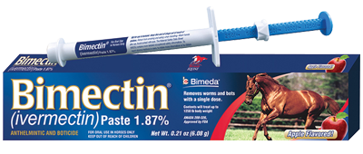
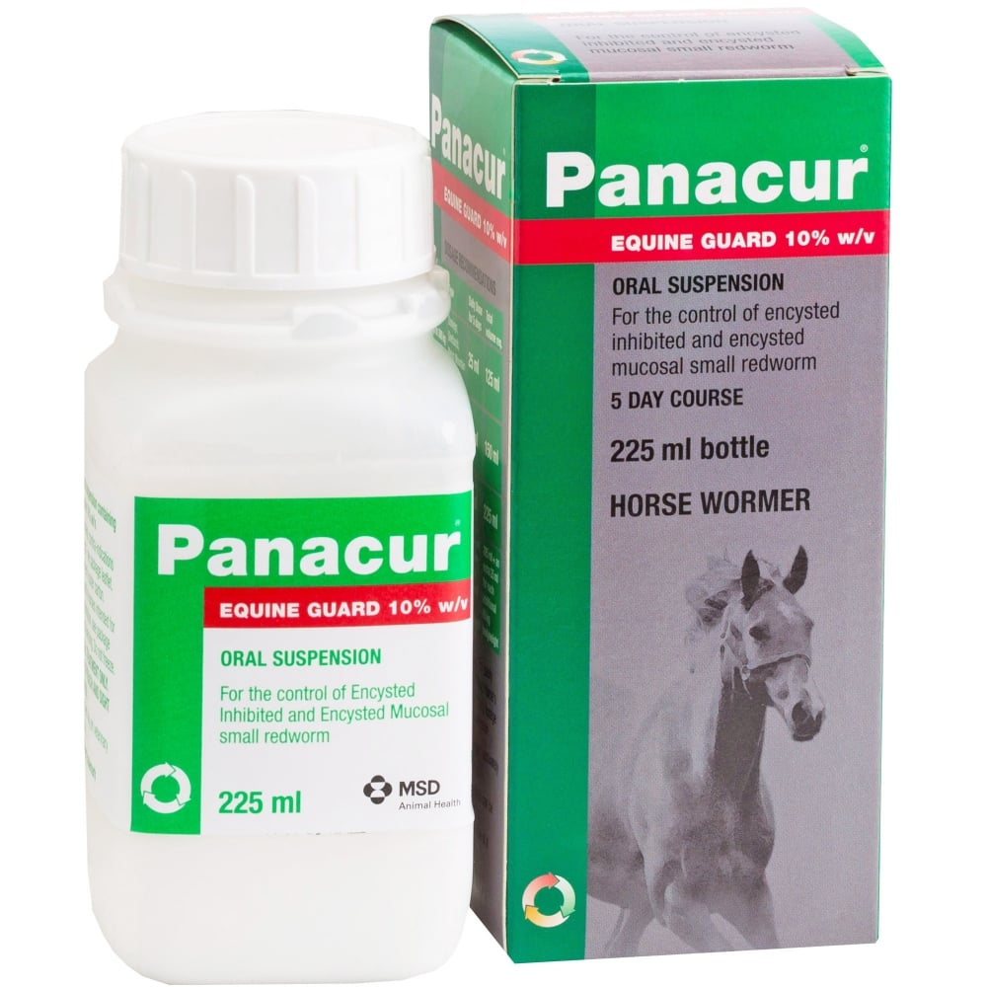
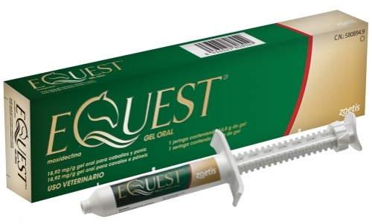
The Wormers
Ivermectin
Moxidectin
Pyrantel
Fenbendazole
Praziquantel

Slide 21
How long to stable a horse after worming?
Strongyles
No need
Unless environmental issues
Parascaris
3 days?

Slide 22
Resistance
Drug | Cyathostomins | Large Strongyles | Ascarids
Ivermectin | Emerging resistance | Full efficacy | Wide-spread resistance
Moxidectin | Emerging resistance | Full efficacy | Wide-spread resistance
Fenbendazole | Wide-spread resistance | Full efficacy | A few published cases
Oxibendazole | Wide-spread resistance | Full efficacy | Full efficacy
Pyrantel | Some resistance | Full efficacy | A few published cases

Slide 23
Preventing resistance?
Rotating products?
Doesn’t influence development of resistance
Combining products?
Doesn’t influence development of resistance
Refugia
Only treating a select proportion of the population
Only treat if high enough FEC?

Slide 24
Faecal Egg Counts
The FEC does NOT directly correlate with number of worms
Below 500epg – number of worms likely to be low
Determination of egg shedding
→ Who is contaminating the pasture
Useful in grazing season!
FEC reduction testing
Ascarids vs strongyles
Clinical diagnosis?
Larval stages!
Notes:
FEC is not directly correlated to intestinal cyathostomin burden, instead indicating those individuals excreting high egg numbers. By targeting treatment only at those with high FEC (over 200 EPG), many worms are left in refugia: on pasture and in untreated horses. This dilutes the surviving cyathostomin gene pool, preventing only resistant worms thriving, thus reducing selection pressure for resistance.
FEC used before and 14 days post-worming (Faecal Egg Count Reduction) tests for anthelmintic resistance in a herd by assessing the mean percentage reduction. Results <90% (fenbendazole/pyrantel) and 95% (ivermectin/moxidectin) indicate resistance. If present, that product shouldn’t be used. Performed annually, the yard can ensure efficacy of used anthelmintics (Lester et al., 2013).

Slide 25
Limitations
Tapeworm ☹ ??
Pinworm ☹
Lungworm ☹
Liver fluke ☹
Cyathostomins in horses under 4 years
Encysted cyathostomins (encysted red worm) ☹
In UK only encysted in Winter
”After first frost”
Blood test in development
Post mortem ☹

Slide 26
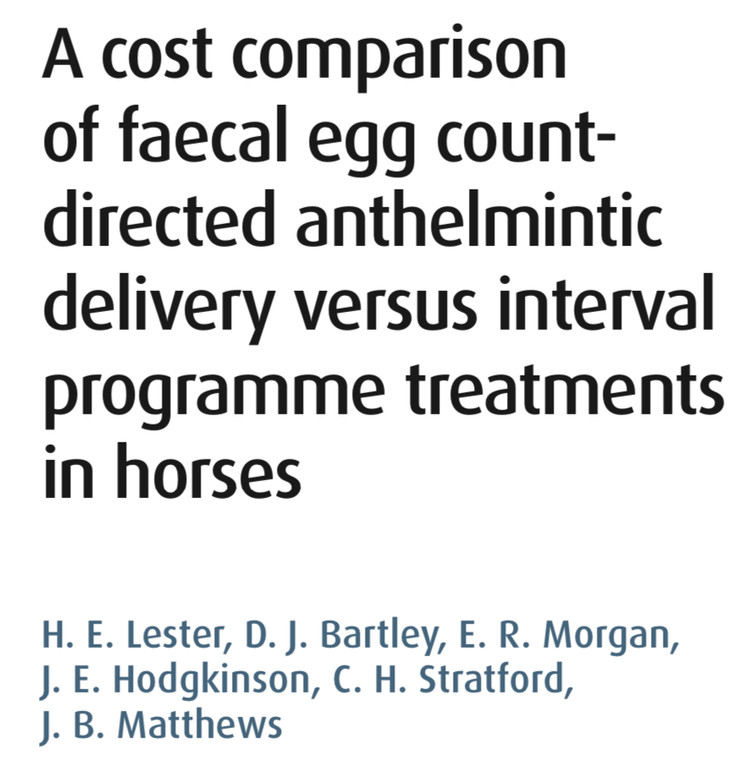
Costs?
Savings £57-£568 per yard/year
18% horses required treatment
”High chance of reducing the financial costs”

Slide 27
How to take a sample
3 x between March and September
>3 faecal balls and mix
Air-expelled container
Refrigerate within 12 hours
Tested within 5 days
Quantitative technique
Vet
External lab

Slide 28
Interpretation
Redworm vs Roundworm vs Tapeworm
<200epg = LOW
Doesn’t currently require treatment
250epg – 1200epg = MEDIUM
Requires treatment
1200+ = HIGH
May need additional or different treatments
Discuss with own vet

Slide 29
Equisal
Direct order from website
Swab in mouth where bit sits
Send away
Tests for ANTIBODIES to the tapeworm
+ve = exposed in last 5 months
-ve = not exposed in last 5 months

Slide 30
Targeted Approach to Worming
Spring | FEC for ascarids and cyathostomins | Equisal for tapeworm?
Summer | FEC for ascarids and cyathostomins
Autumn | FEC for ascarids and cyathostomins | Equisal for tapeworm
Winter | Worm against encysted cyathostomins Test for resistance?

Slide 31
Westgate Labs
Faecal Egg Count
£5.50 + VAT (£6.60)
(Usually £9.95 per horse)
Equisal
£12 + VAT (£14.40)
(Usually £17.95 per horse)
Per horse = 3 x FEC + 2 x Equisal = £48.60
Minimum = 2 x FEC + 1 x Equisal = £27.60
OR… 2-3 x FEC then tape wormer in Winter with moxidectin (Equest Pramox)

Slide 32
Intelligent Worming
Complementary worming MOT
25% off FEC
15% off wormers
50% off monthly fee (£1 instead of £2 per horse)

Slide 33
The Veterinary Surgeon
Many practices perform their own FEC
Individual groups may wish to ask for prices/discount for charity themselves if used to using vets
Many practices will be happy to discuss FEC from other companies if approached in the right way!

Slide 34
RDA

Slide 35
The Aim
Create relationships with Westgate/IW
Discounted FEC
Discounted Equisal
RDA specific form to encourage use
Education programme of need for targeted worming

Slide 36
Thank you
Lets come up with a plan…
Notes:
Thank you all very much. Please can you all now get your Coaching Passports out and I will come round and sign off that you have completed the module.

